Slide 1

Recruit Me
CMPE 272 Project Presentation :
Chetan Gour
Vineet Karmiani
Vinayak Kini
Raj Choksi

Slide 2
Overview
Recruiting web application with Tinder like UI
FrontEnd : React, HTML5/CSS3, BootStrap
Used JWT and OTP based authentication for Login/Signup
Server Side : Node.js, Express.js, MongoDB
Recommendation : Elastic Search

Slide 3
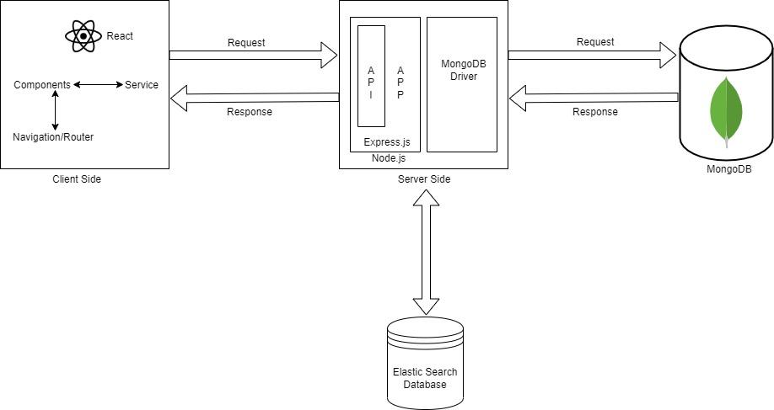
Architecture Diagram

Slide 4
Functionalities
Candidate:
Create a suitable profile to get Job recommendations.
Search for Jobs based on Skills.
Get job recommendations based on Skills.
View all the job postings.
Filter jobs according to Skills, type and seniority level.
Recruiter:
Create a new Job and specify all the requirements.
Gets recommended candidates among those who have applied for the Job.

Slide 5
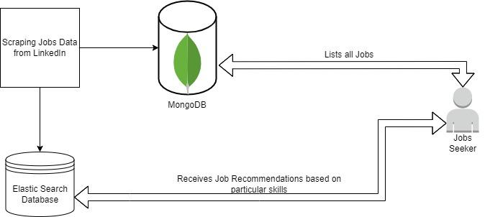
Elastic Search

Slide 6
Future Scope
Fraud Job/Applicant detection.
No more resumes and Profiles.
Using AI for candidate screening.

